Slide 1
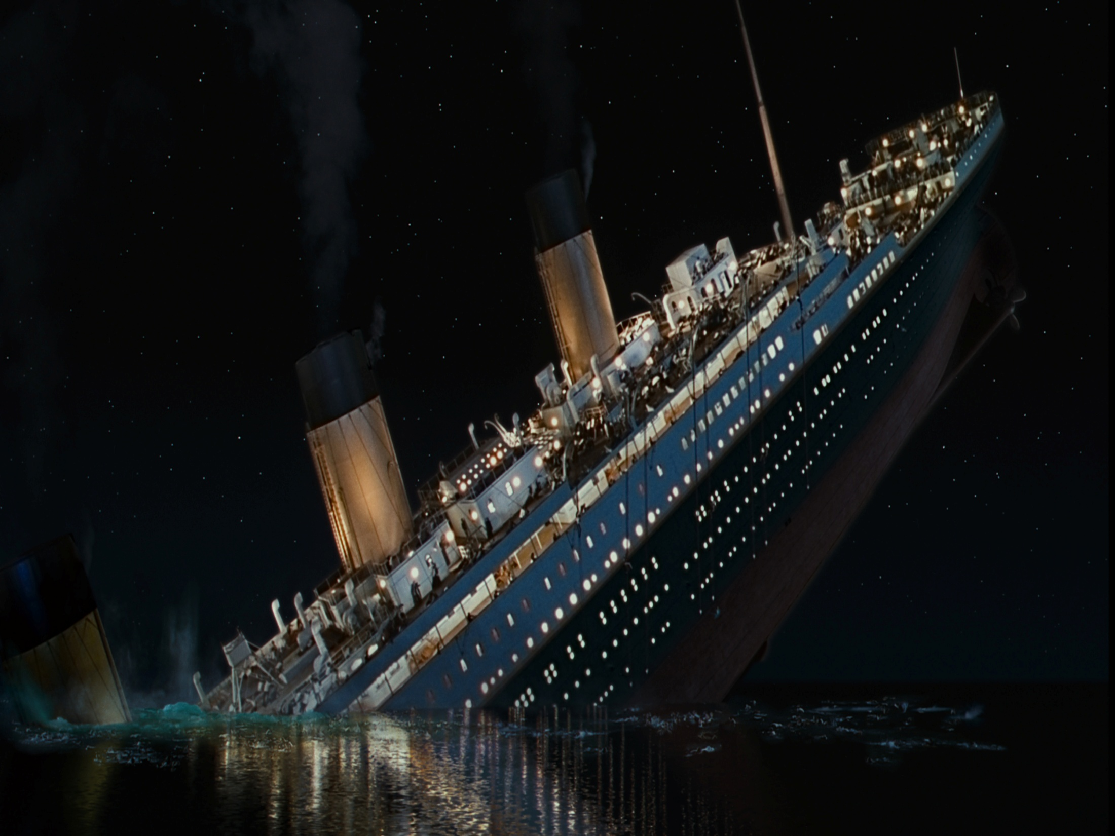
Predictive survival using R
Name: Pratik Patel
Class: CS 483 Big Data Analytics capstone
Professor: Elena Braynova

Slide 2
Description
The project is based on one of the horrific tragedy that took place in the year 1912.
The Titanic sank and 1502 people died in this heartbreaking incident.
My purpose is to analyze data using predictive task
Figure out which people are likely to survive in this kind of similar incident in future.
Datasets available from that tragedy
Test.csv
Train.csv

Slide 3
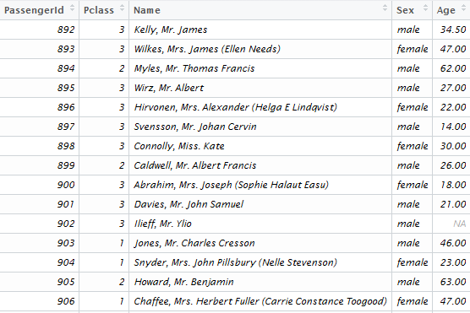
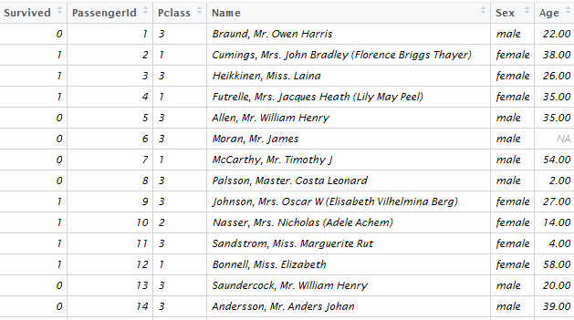
Datasets:
Test.csv
Train.csv

Slide 4
Variables description:
Survival: (0 = no, 1 = yes)
Pclass: (1 = 1st class, 2 = 2nd class, 3 = 3rd class)
SibSp: Number of siblings/spouses aboard
Embarked: (C = Cherbourg, Q = Queenstown, S = Southampton)
Parch: number of children or parents onboard

Slide 5
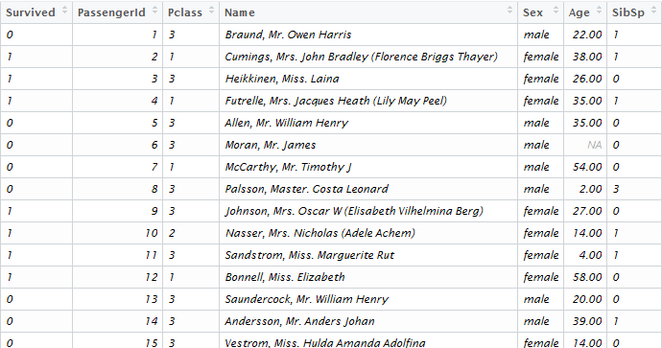
data.combined

Slide 6
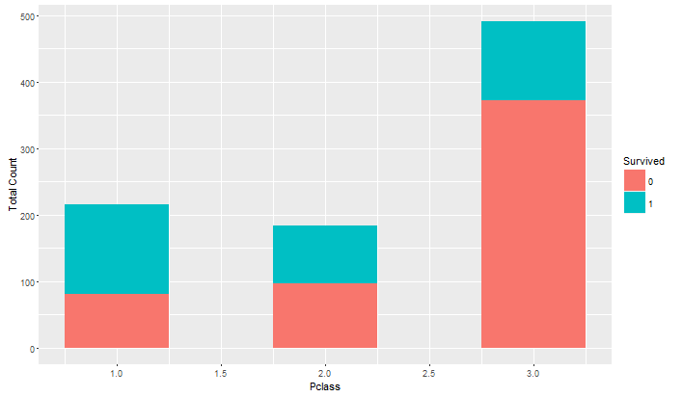
Hypothesis I
First class passenger has easy access to lifeboats.

Slide 7
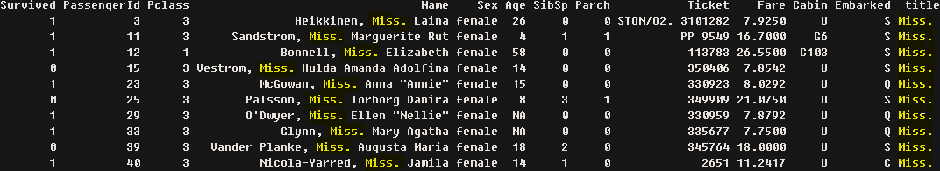
Title variable
Added title variable into the data.combined from the passengers names.
Pclass = 3rd class passengers
Survival rates = most of them survived
Mostly young women from the 3rd class survived

Slide 8
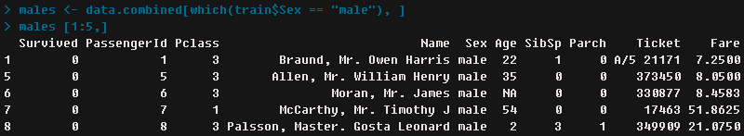
Male passenger
Survival rates = close to none
Pclass = 3rd class
Parch = most of them without parents or children

Slide 9
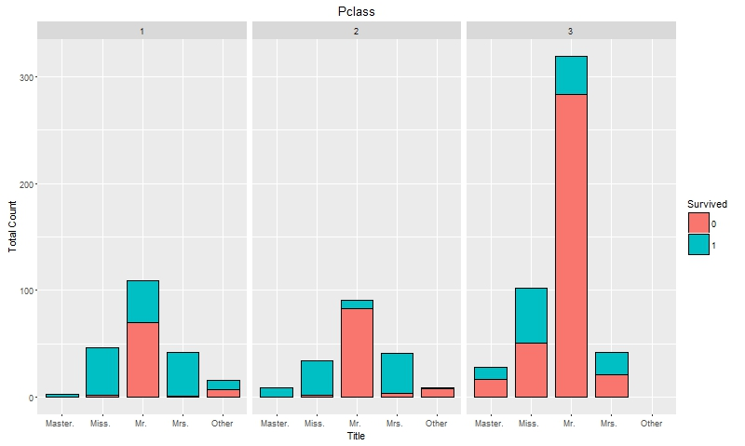
Plot using Title variable
Male survival rates = 1st class 40/60, 2nd class 10/90 and 3rd class 15/85 (roughly)
Female survival rates = 1st class 4/96, 2nd 5/95 and 3rd 50/50

Slide 10
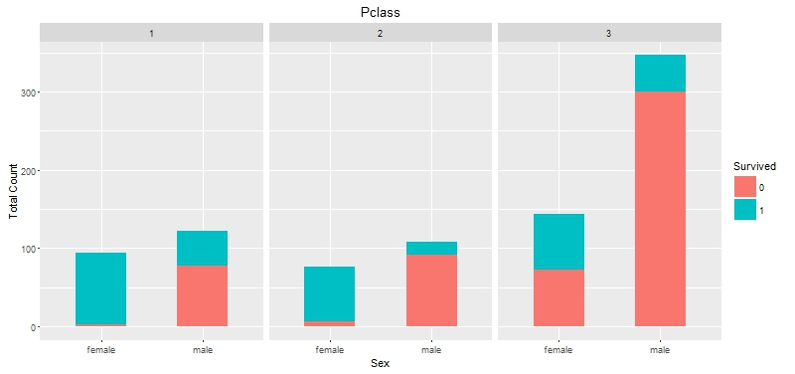
Three way relationships sex, Pclass and survival
Male vs. female in 1st, 2nd and 3rd class survival rates.

Slide 11
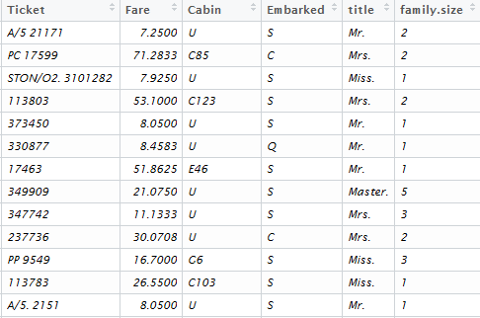
Added family size
Family size variable created
temp.sibsp <- c(train$SibSp , test$SibSp)
temp.parch <- c(train$Parch, test$Parch)
data.combined$family.size <- as.factor(temp.sibsp + temp.parch + 1)

Slide 12
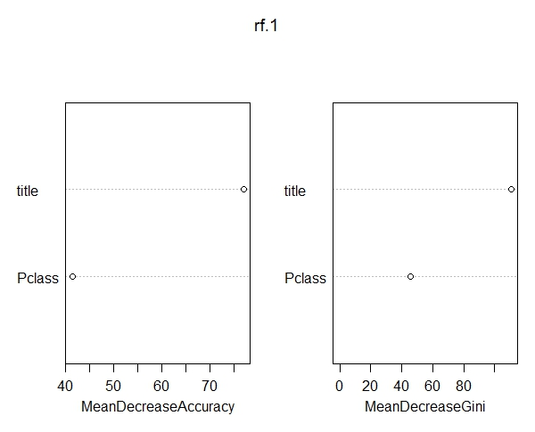
RandomForest
Pclass and title variable with 21.44% error rate

Slide 13
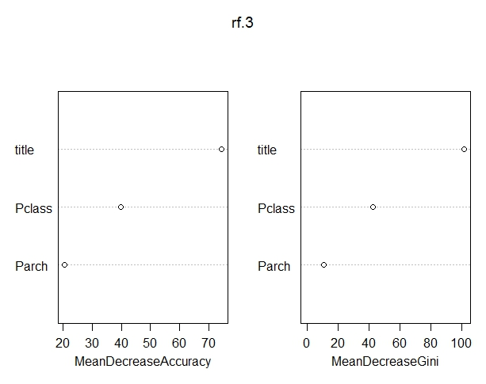
RandomForest
Pclass, Title and Parch with 19.64% error rate

Slide 14
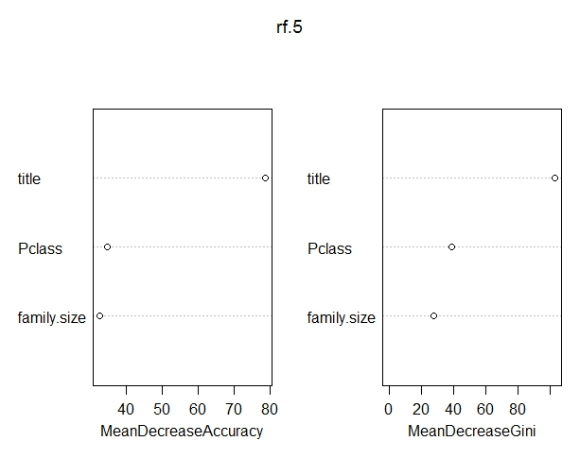
RandomForest that works the best
Pclass, Title and family Size with 18.07% error rate

Slide 15
Work cited
https://www.kaggle.com/c/titanic

